Slide 1
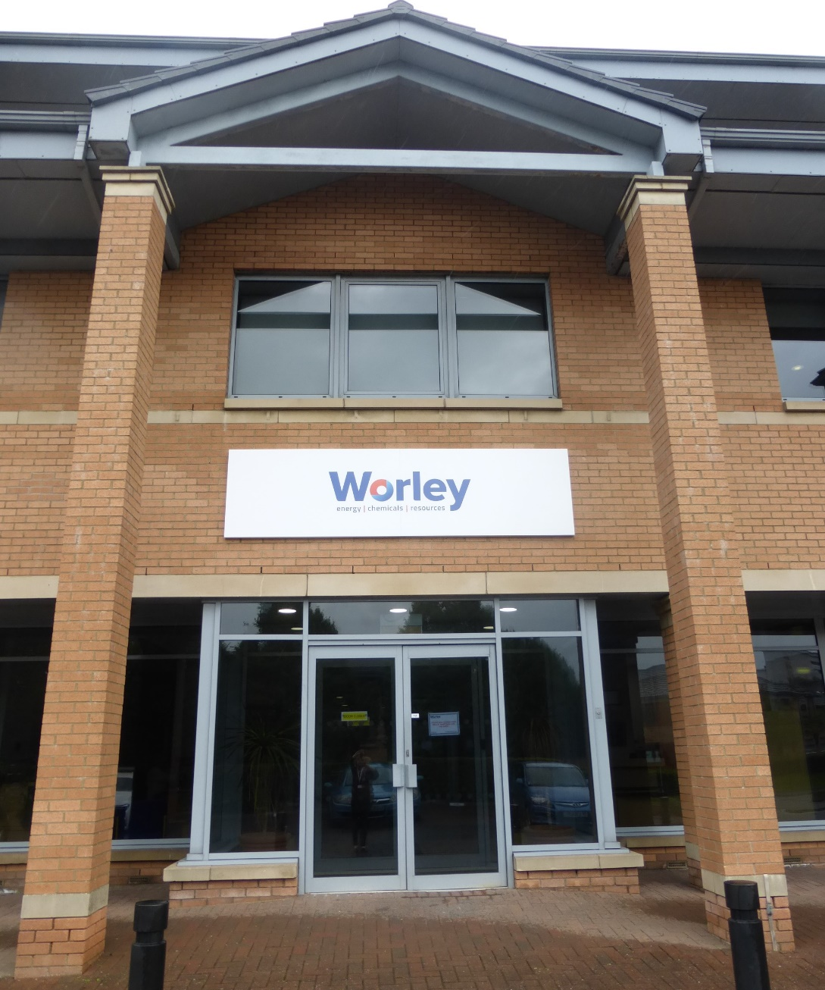


Welcome to KC Group Shipping Ltd and KYFI UK Ltd in the Worley Building
Glasgow Office HSE Induction

Slide 2
Welcome to KC Group Shipping Ltd and KYFI UK Ltd in the Worley Building
Your health, safety and security is important to us.
  We want to ensure that everyone . . .
    Has sufficient knowledge to work safely
    Knows how to react in an emergency
    Feels safe and secure at work and goes home safely at the end of the working day
  Please make sure you understand your role in maintaining our high standards at this facility.

Slide 3
Health & Safety at Work Act 1974
Section 2
Employer’s General Duty
  To ensure as far as is reasonably practicable the health, safety and welfare of his employees.
Sections 7 & 8
Employee’s Duties
  To ensure their own health and safety and the health and safety of others.
  To co-operate with their employer on matters relating to health and safety.
  Not to interfere with anything provided in the interests of health and safety.

Slide 4
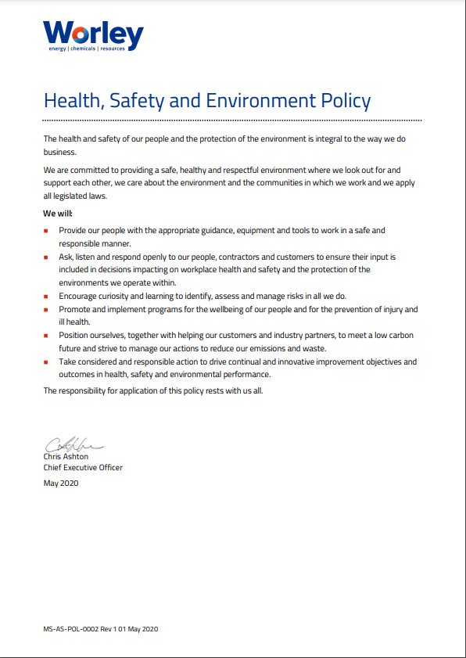
HSE Policy
  This policy is a statement of our HSE commitments and expectations.
  It is underpinned by our management system framework and organisational arrangements but fundamentally it is built on the foundations of our behaviours and attitudes to HSE.
  It is displayed on HSE notice boards throughout the office along with copies of current Company safety alerts.

Slide 5

Emergency Evacuation
Action on discovery of smoke or fire
  Operate the nearest fire alarm call point
  Leave by your nearest exit
  Do not attempt to use Fire Extinguishers to put out the fire

Slide 6

Emergency Evacuation
Actions on hearing the Fire Alarm
  Evacuate via the emergency exits and assemble at the emergency assembly points
  Follow the Floor Leaders’ instructions
  Observe the following:
    Do not delay to collect personal items
    Do not use the lift
    Do not attempt to phone Reception or Facilities Management
    Do not attempt to re-enter the building until authorised by Facilities Management/Floor Leaders
    Do not loiter on roadways
    Do not smoke at the assembly points
  Visitors should remain with their hosts

Slide 7
Emergency Evacuation
  Escape Routes:

Slide 8
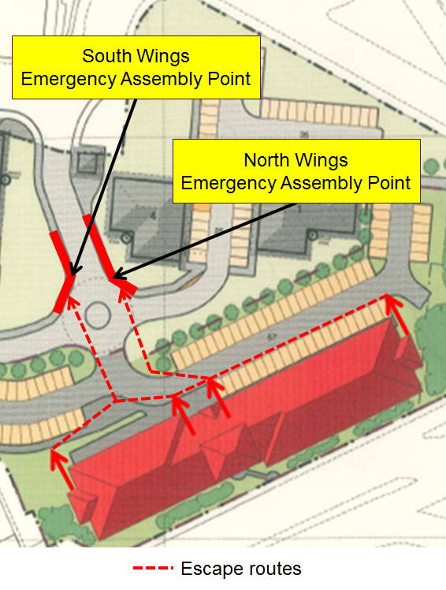
Emergency Evacuation
  Emergency Assembly Points:
    South Wings muster on pavement on left side of main entrance road
    North Wings muster on pavement on right side of main entrance road

Slide 9
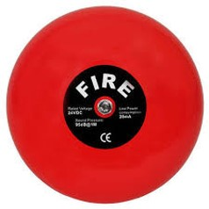
Emergency Evacuation
  Fire Test and Drills:
    The audible fire alarm is tested at 09.00 every Friday
    Evacuation drills carried out every 6 months
  Personnel who may require assistance in the case of an emergency evacuation should contact Facilities Management to complete a PEEP (Personal Emergency Evacuation Plan)

Slide 10
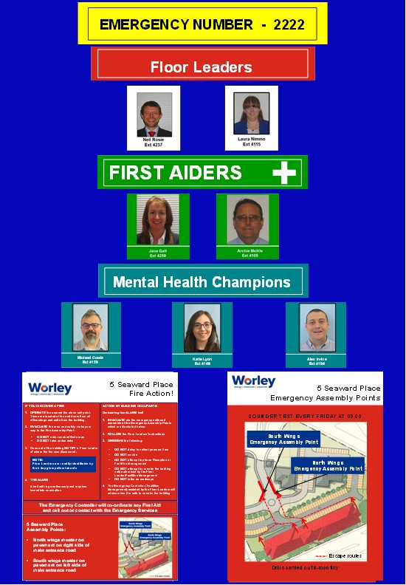
Emergency Information
You will find Emergency Notice Boards located in each office area
  These identify:
    Emergency Number
    Floor Leaders
    First Aiders
    Mental Health Champions
    Fire Action Plans
    Emergency Assembly Points
  Please take some time to familiarise yourself with the information for the office area in which you are working.

Slide 11
Emergency Information
  First Aiders:
    Chris McGowan and Lorraine Murphy
  Worley Floor Leaders:
    Seated under/beside a red triangle
    In the event of an emergency situation they will be readily identifiable by their day-glow yellow tabards
  KC Fire Marshals:
    Lesley Boyce and Kate Abernethy
  Defibrillator:
    Available in Reception
FIRST AIDER
FLOOR LEADER

Slide 12
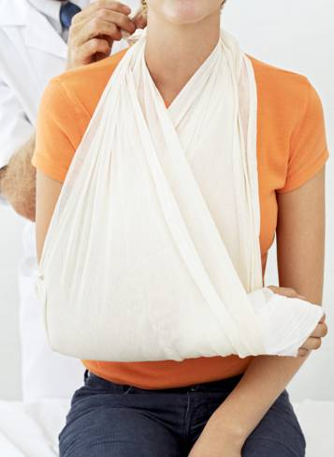
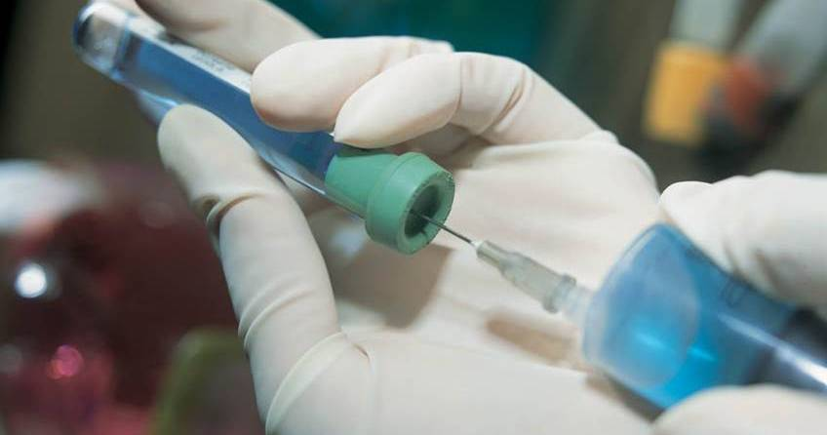

Medical Emergency
REPORT Emergency by telephoning 999 or
CONTACT your local First Aider
  Seated under/next to a suspended green triangle
  Details on the Emergency Notice Boards

Slide 13
Bomb Threat
Action on receiving a bomb threat
  Remain calm
  Keep the caller on the telephone as long as possible and make notes on accents, mannerisms, repeated words or phrases
  Report all details of the threat to your manager immediately
Action on finding a suspicious object
  Inform Reception immediately (2222) who will inform FM.
  Do not touch or move the object.
  Move people away from the object.
  FM will manage the situation appropriately.

Slide 14
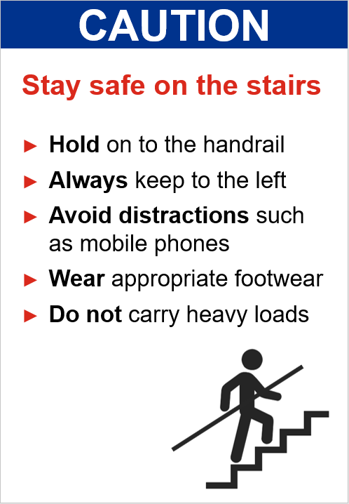
Office Safety
  Take care on the stairs – hold on to handrails, always keep to the left, don’t use your mobile phone, wear appropriate footwear and don’t carry heavy/awkward loads.
  Lids required on hot drinks/food being transported from one office area to another.

Slide 15
Office Safety
  Keep aisles and walkways clear at all times.
  Close desk and file drawers that are not in use.
  Watch for doors opening suddenly and open them slowly.
  Visually inspect electrical equipment/cables and report defects immediately
  Never walk past a safety hazard – if you see it, make it safe and then report it to Facilities Management

Slide 16
Office Safety
  Manual Handling
    Manual handling should only be carried out by trained staff.
    Anyone requiring boxes, etc. moved should contact Facilities Management.
  Spillages
    Any spillages of water, coffee, etc. should be reported to Facilities Management immediately in order that they can be cleaned up as quickly as possible.
  High Level Storage
    Files, boxes, folders, etc. must not be stored on top of high level cupboards.
    Where high level storage is unavoidable, staff must not use chairs, stools, ladders, etc. but should contact Facilities Management who will utilise appropriate equipment to access high shelves.

Slide 17
Office Safety
Working outside Normal Hours
  Those who need to work outside of normal hours or undertake weekend working must first obtain authorisation from their line manager who will inform Facilities Management.
  A signing in system is maintained by Security and this must be completed by anyone working outside normal hours.
  Access may be denied if you are not on the weekend working list.
  A Lone Working procedure is operated for anyone working outside of normal hours or at weekends, and a register is maintained by Security.
  If you are working alone in one of the office wings, you must let Security know and sign the lone working register.
  If required, Security can escort staff walking to furthest corners of car park/on-street parking/nearest public transport location after dark.

Slide 18

Car Park
Please do:
  Reverse park in the demarcated spaces.
  Be aware of pedestrians.
  When walking between your car and the office stay vigilant.
  Adhere to Business Park speed limit of 5 mph.
Please don’t:
  Park in the disabled parking bays, they are for disability badge holders only.
  Park on double yellow lines or in the turning bay.
  Leave cars overnight unless authorised in advance via Facilities Management.
  Drive or park on the demarcated pedestrian walkway.
  Park in spaces allocated to our tenants.

Slide 19
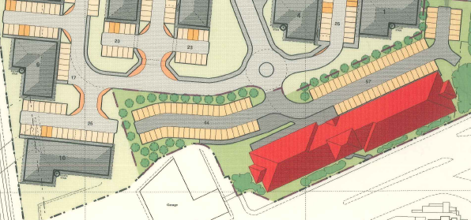
5 Seaward Place Parking Allocations
Key:
Worley staff
Worley Visitors
Pulsant (Staff)
Pulsant (Visitors)
KC Shipping/KYFI
Disabled
Recycling
19

Slide 20


Office Security
  Worley operates a computerised card access control system for itself and its tenants and individuals are issued with a photographic security pass.
  You must display your security pass at all times and respectfully challenge anyone not wearing theirs.
  If your security pass is lost or stolen, inform Facilities Management immediately.
  Lock your computer screen when left unattended (Ctrl-Alt-Del).
  Clear desk policy – lock away sensitive information when not in use and when you leave the office.

Slide 21

Doing the right thing
Take 5 for Safety
  Take 5 is a refreshed approach to empower you to identify the solution and control the danger.
  It provides a process for you to use your natural instincts to review your work area to:
    STOP, thinking and focusing on what you are about to do
    LOOK 360° around you for a minimum distance of 5 metres, and for at least 20 seconds to become aware of your work area.
    IDENTIFY any dangers that could hurt you or your team
    DISCUSS the dangers you have found
    CONTROL the dangers to make it safe to start

Slide 22
Doing the right thing
Take 5 for Safety
  Take 5 works when YOU and YOUR TEAM use the process to continuously review the task and controls before, during and after the job to take cognisance of changes to the work environment.
  It enables YOU to take ownership over the last line of defence to identify and control the dangers and complete the job safely.
  When YOU are in control, YOU are empowered to influence the course of events and enhance the ability to prevent injury.

Slide 23

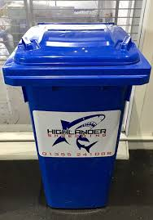
Doing the right thing
Recycling
  There are recycle bins for plastics, cans and general waste located in each office area and in the amenities Area.
  There is a bin for glass recycling in the Amenities Area.
  There are large blue wheelie bins for recycling paper in each office area. These are uplifted on a regular basis and the contents confidentially destroyed.
  Any cardboard for recycling can be left next to the blue wheelie bins.
  Please think carefully before depositing recycling – anything incorrectly deposited results in the contents of that bin being discarded as general waste for landfill, and defeats the purpose of recycling.
General Waste
Plastics
Cans
Glass
Paper

Slide 24
Recommendations
Before the end of your first week in the office, take a few minutes to familiarise yourself with your new equipment and location of the following:
  Emergency Exits
  Fire Call Points
  Emergency Assembly Points
  Emergency Notice boards
  First Aiders & Floor Leaders
  Welfare Facilities
  Recycling Bins

Slide 25
Summary
  Health and Safety is everyone’s responsibility
  Report all incidents, injuries and near misses
  Follow safe work procedures
  Identify, assess and control the specific hazards of your workplace
  Nothing is so urgent or important that it overrides this commitment.
Think SAFE!

